Slide 1
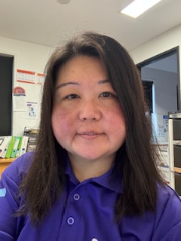
Smalls Road OSHClub
Update: Term 2, Week 7 & 8, 2025
Message from the Coordinator, Isabelle.
Hello Lovely Families!,
Our Winter Holiday Program for July is
out now. Please find the attachment for our program. We have limited places available.
Monday 21st July 2025, is a Pupil Free Day. Places are not open at the moment, but I will let you know when it is. ☺☺
Just a reminder if your child is attending any extra-curricular activity during any sessions at OSHClub, there is a form that needs to be filled out.
Just a reminder to sign in and out your child/ren when you are dropping off your child or picking them up.
This is an important notice to remind you that you are required under Government Regulations and Family Assistance Law to sign your child in and out of the service each day/session that they attend. You are also required to notify the Centre before each session of your child’s scheduled day if they will not be attending for any reason e.g. sickness.
Rise then Shine Update
Stay and Play Update
Children have been busy inside and outside. Some of the activities that the children participated in were:
paper plate wreath, paper plate bag, finger painting, DIY Leis, loom bands, making chocolate crackles, paper plate hot air balloons, collage, slime, pin the tail on the donkey, What’s the time Mr Wolf, bullrush, handball competition, running relay, duck, duck goose, sandpit play, dodgeball and four corners.
We would like to get some feedback or suggestions on our weekly menu for both breakfast and afternoon tea and would like to hear from you. Our weekly menu is displayed near the kitchen door. If you have any questions, please let me know. ☺
In the afternoon, the children are enjoying outdoor play. Please ensure hats, water bottles and jumpers are labelled with your child’s name.
Some of the activities that the children have been participating in are:
collage making, make your own wand, make your own shield, make your own mask, Mexican banner, international picnic day, hope lantern, calming jar, playing tip, bullrush, obstacle course, soccer, scavenger hunt, yoga session and Sydney FC skills.
If you have any ideas or suggestions you would like to put into the program, please do not hesitate to email me and this may be implemented into our program. We would love to hear from you. ☺
Service details
Our contact details are:
Other information:
0419 903 198
Rise then Shine and Stay & Play:
Spots Available - Every Morning
- Mon, Wed, Fri Afternoon
smallsroad@oshclub.com.au
OSHClub is a proudly owned and operated by Junior Adventures Group

Slide 2
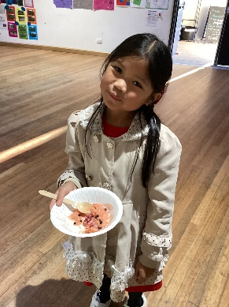
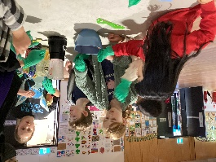
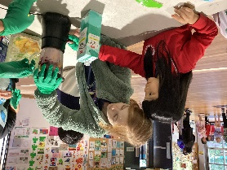
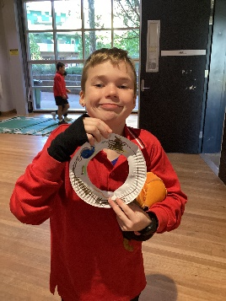
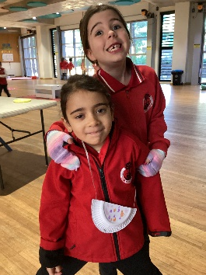
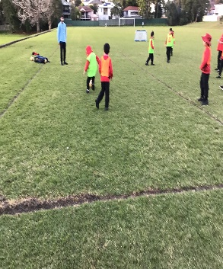
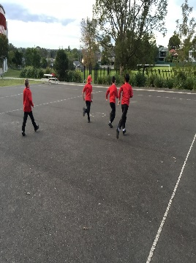
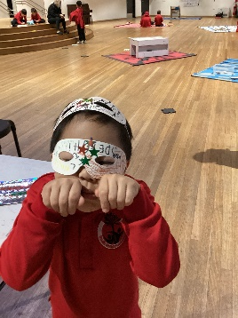
https://www.thedreamrun.com.au/fundraisers/nswsmallsroad/the-dream-run-2025
Smalls Road OSHClub
Update: Term 2, week 7 & 8, 2025
Cooking Club
Every Tuesday afternoon, we hold ‘Cooking Club’ which runs from 4:00pm to 5:00pm. Children are showing great interest and enjoying what they are making during this time.
This week we made an ‘Acai Bowl’.
During this activity, we split the group into several smaller groups and they all took turns to help make the Acai Bowl.
They helped read the recipe and the steps we needed to complete the process.
The children got to eat their own Acai Bowl after.
Please see the photos below.
Happy Snaps
‘The Smith Family – Dream Run Fundraiser’
Lost Property
Smalls Road OSHClub are raising money for ‘The Smith Family’ as a part of ‘The Dream Run’ charity event. All money raised goes to help provide more children with the essentials they need for school, like uniforms, books and access to life changing learning support – so they can fit in, keep up at school and thrive into the future.
On Tuesday Afternoon 17/06/2025, we held a ‘Bake Sale’ and it was a great success and raised $261. I would like to say, a big ‘Thank you’ to the children and families for supporting this charity event.
Next Wednesday 25th June 2025 at 4:00pm, we will have ice creams, ice blocks and hot chips for sale.
Please support us by donating through the link below. Every dollar counts.
https://www.thedreamrun.com.au/fundraisers/nswsmallsroad/the-dream-run-2025
We have placed 'Lost Property' outside the OSHClub door now. We will be hanging up any lost items in our new area - against the wall (outside) when you come out from the hall.
Every Monday morning, I will be taking the lost property items to the school office lost property area if it still in the basket. Any items that have not been collected will be going to a donation bin.

